Slide 1
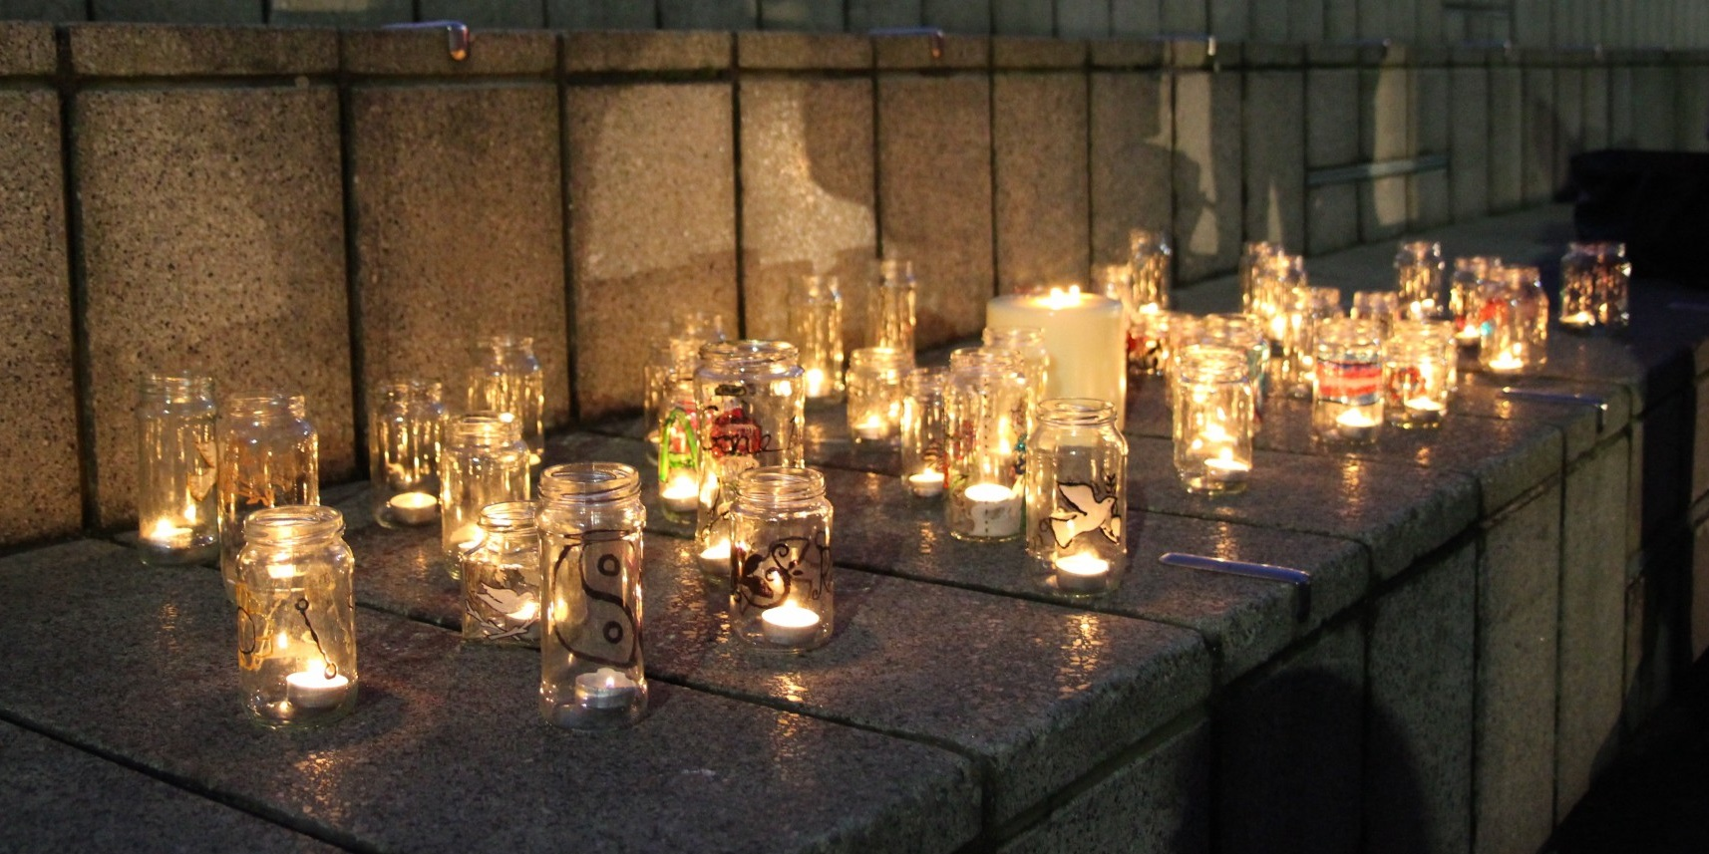
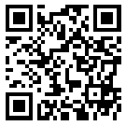
Trans Lives Matter: Remembering Our Dead Trans Day of Remembrance 2024
https://tdor.translivesmatter.info/

Slide 2

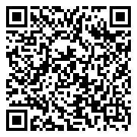
Grazziella Takahashi Cavalcante Santa Maria, Rio Grande Do Sul (Brazil) 1 Oct 2023

Slide 3
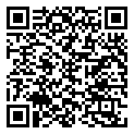
Name Unknown Meenakshipuram, Tamil Nadu (India) 1 Oct 2023

Slide 4
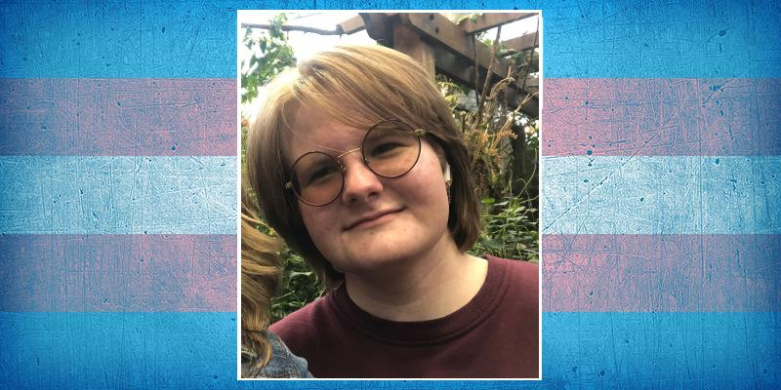
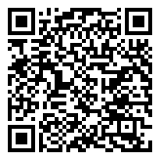
Allen O'Donnell Age 20 Brockport, New York (USA) suicide. 1 Oct 2023

Slide 5
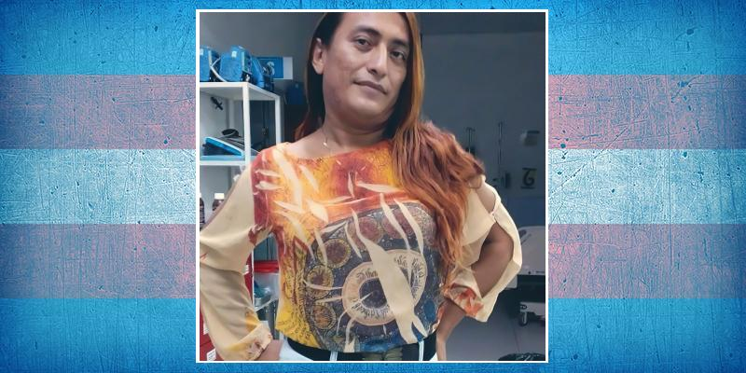
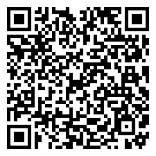
Gabriela Rodríguez Rodríguez Age 26-30 Tegucigalpa, Distrito Central (Honduras) shot. 1 Oct 2023

Slide 6
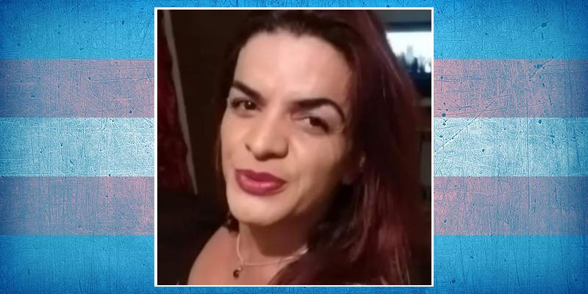
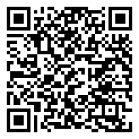
Amanda Martins Age 40 Guarapuava, Paraná (Brazil) stabbed. 2 Oct 2023

Slide 7
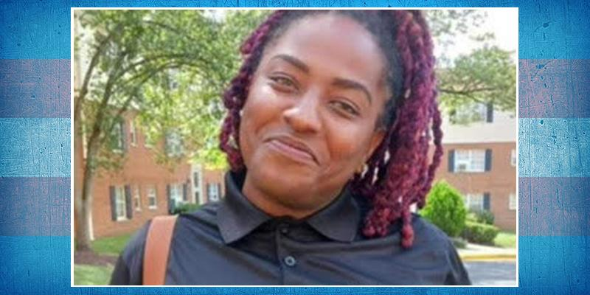
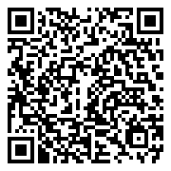
Skylar Harrison Reeves Age 30 Washington, D.C. (USA) overdose. 2 Oct 2023

Slide 8
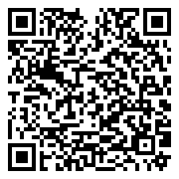
Shakira Villa Centeno Age 31-40 Santa Marta, Magdalena (Colombia) shot. 7 Oct 2023

Slide 9
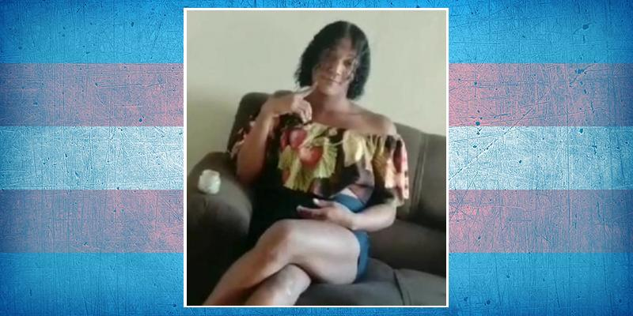
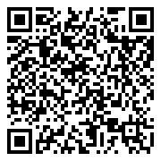
Tainá de Souza Rodrigues ("Katarina") Age 21 Juazeiro do Norte, Ceará (Brazil) shot. 7 Oct 2023

Slide 10
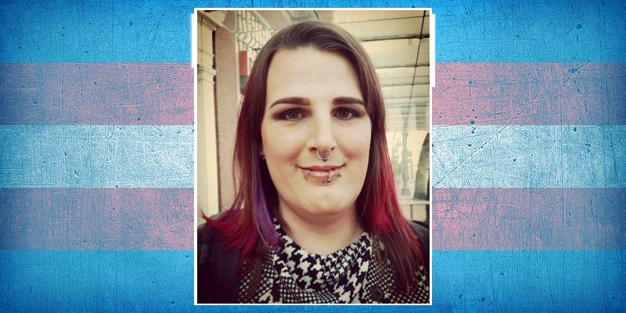
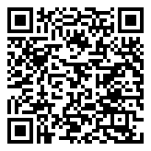
Rani Baker Portland, Oregon (USA) suicide. 8 Oct 2023

Slide 11

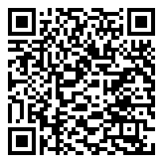
Vivian Maldonado Age 32 Luziânia, Goiás (Brazil) stabbed. 8 Oct 2023

Slide 12
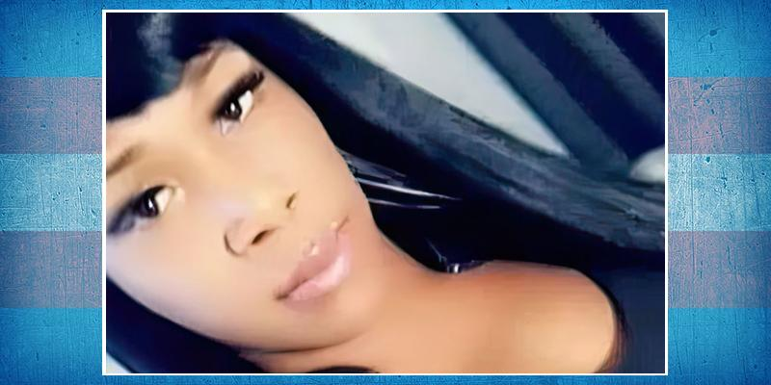
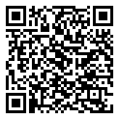
Chyna Long Age 30 Milwaukee, Wisconsin (USA) shot. 8 Oct 2023

Slide 13
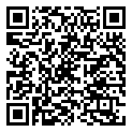
Name Unknown Age 30 La Resurreccion, Puebla (Mexico) beaten and shot. 9 Oct 2023

Slide 14
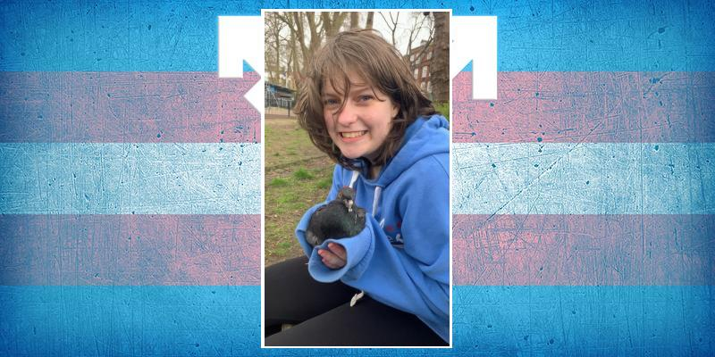
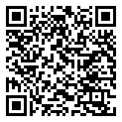
Corei Hall Age 14 London (United Kingdom) suicide. 12 Oct 2023

Slide 15
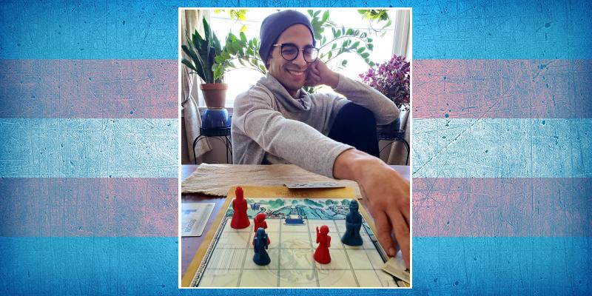
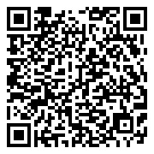
Cris Velazquez Age 37 Philadelphia, Pennsylvania (USA) suicide. 12 Oct 2023

Slide 16
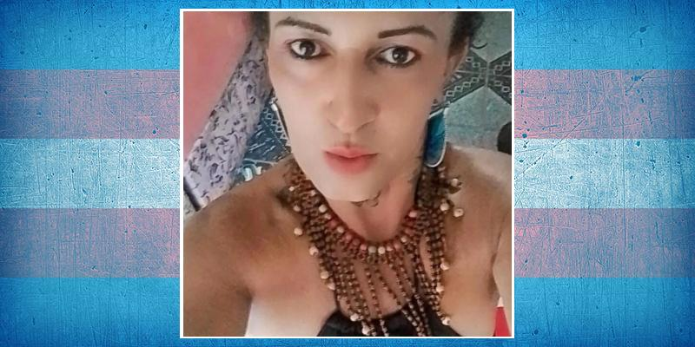
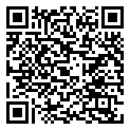
Dulce Maria Age 47 Serra Redonda, Paraíba (Brazil) shot. 13 Oct 2023

Slide 17
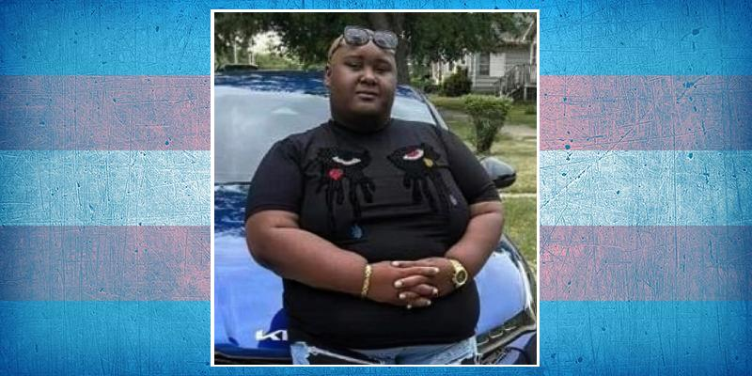
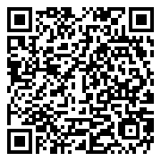
Dominic Dupree/Dominic Palace Age 25 Chicago, Illinois (USA) shot. 13 Oct 2023

Slide 18
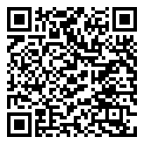
Chay Sophya Age 19 Manaus, Amazonas (Brazil) shot. 14 Oct 2023

Slide 19
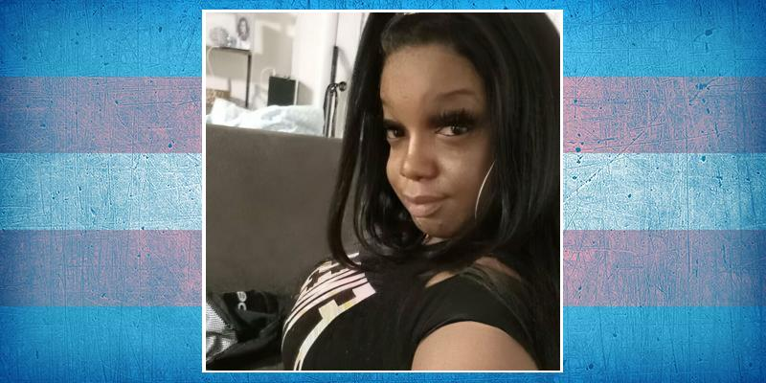
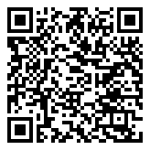
A'nee Roberson Age 30 Washington, D.C. (USA) run over. 14 Oct 2023

Slide 20
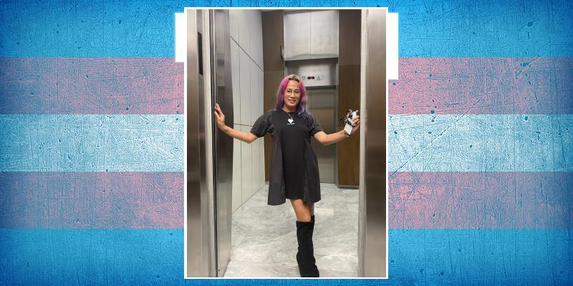
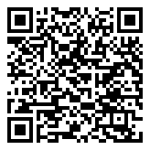
Choi Pabillo Age 36 Ternate, Cavite (Philippines) murdered. 14 Oct 2023

Slide 21
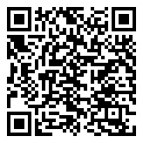
Name Unknown Iguala, Guerrerro (Mexico) shot. 15 Oct 2023

Slide 22
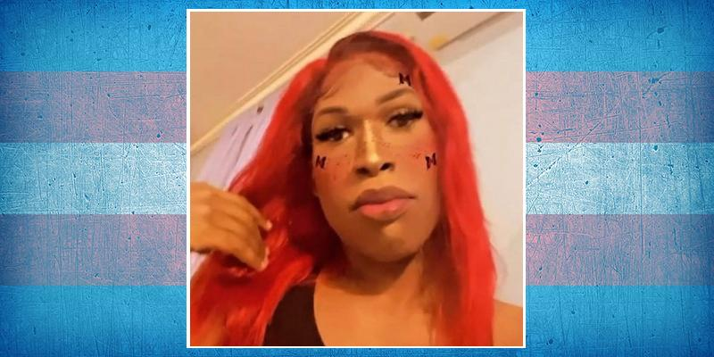
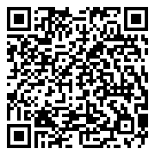
Goldie Alleyne Port Au Spain (Trinidad And Tobago) stabbed. 15 Oct 2023

Slide 23
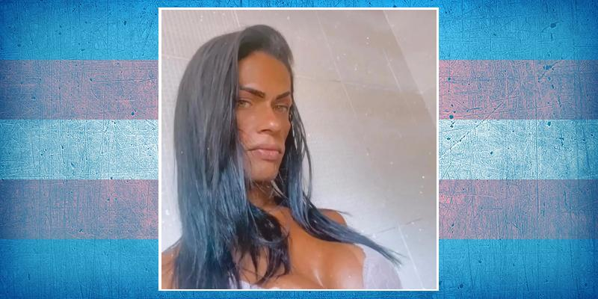
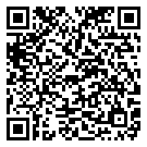
Valentina Reis Rodrigues ("Fabinha") Age 37 Belford Roxo, Rio de Janeiro (Brazil) beaten. 16 Oct 2023

Slide 24
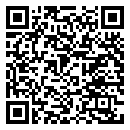
Keny Age 16 Santiago (Chile) shot. 16 Oct 2023

Slide 25
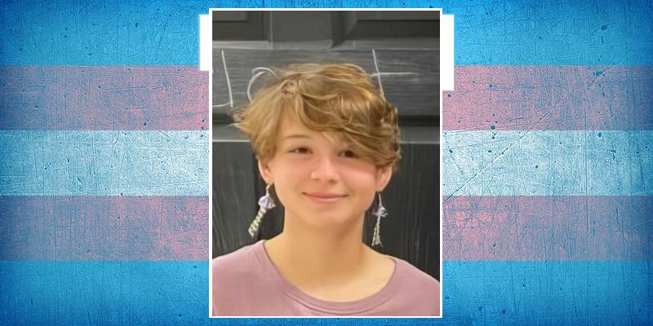
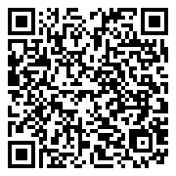
River Paige Olmsted Age 17 Lancaster, Pennsylvania (USA) suicide. 16 Oct 2023

Slide 26
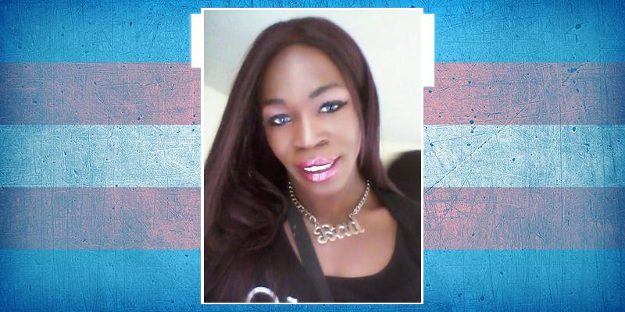
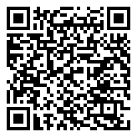
Lisa Love Turman Age 35 Chicago, Illinois (USA) shot. 17 Oct 2023

Slide 27
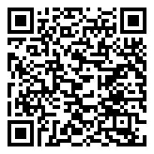
Dayallammal Age 50 Chennai, Tamil Nadu (India) stabbed. 17 Oct 2023

Slide 28
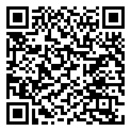
Carla Perez Age 30 Belo Horizonte, Minas Gerais (Brazil) shot. 18 Oct 2023

Slide 29
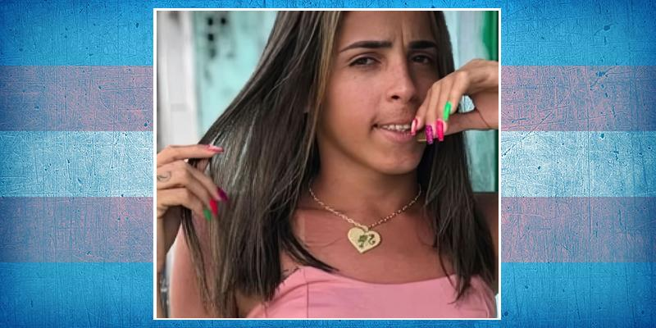
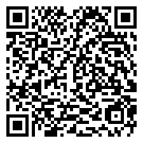
Evelin Sofia da Silva Age 24 Recife, Pernambuco (Brazil) shot. 18 Oct 2023

Slide 30
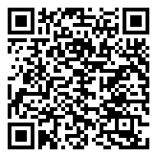
Name Unknown Curitiba, Paraná (Brazil) 18 Oct 2023

Slide 31
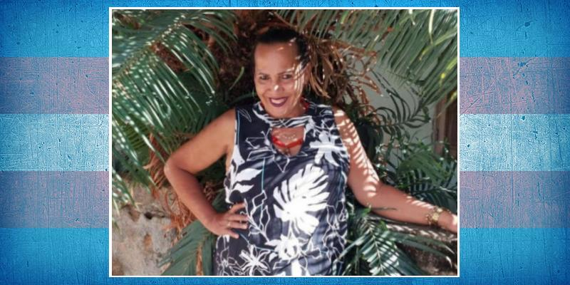

Liah Félix da Silva Age 60 Iperaruna, Rio de Janeiro (Brazil) shot. 19 Oct 2023

Slide 32


Mara Brandão dos Santos Age 39 São Paulo (Brazil) stabbed. 20 Oct 2023

Slide 33


London Price Age 26 Miami-Dade, Florida (USA) shot. 23 Oct 2023

Slide 34

Name Unknown Cabo Frio, Rio de Janeiro (Brazil) stabbed. 23 Oct 2023

Slide 35


Mya Finch Age 36 Boston, Massachusetts (USA) 24 Oct 2023

Slide 36


Tieta Fernandez Bela Vista, São Paulo (Brazil) stabbed. 25 Oct 2023

Slide 37

Erick Salinas Age 38 Potosí, Sucre (Bolivia) stabbed. 26 Oct 2023

Slide 38


Gaby Oliveira da Silva Nísia Floresta, Rio Grande do Norte (Brazil) murdered. 26 Oct 2023

Slide 39

Samantha Age 35 Cancún, Quintana Roo (Mexico) shot. 28 Oct 2023

Slide 40

A. Islam Guwahati, Assam (India) stabbed. 28 Oct 2023

Slide 41

La Pajarita Santa Cruz de Yojoa, Cortés (Honduras) suicide. 29 Oct 2023

Slide 42


Maruca Rodríguez ("Maru") Age 41-50 San Juan Pueblo, Atlántida (Honduras) shot. 29 Oct 2023

Slide 43

Naomi McNew Kokomo, Indiana (USA) suicide. 30 Oct 2023

Slide 44

Pamela ("La Pabli") Sincelejo, Sucre (Colombia) shot. 31 Oct 2023

Slide 45


Rafael Age 23 Timóteo, Minas Gerais (Brazil) shot. 1 Nov 2023

Slide 46


Carla Marques Ramirez Pedreira Age 50 Dourados, Mato Grosso do Sul (Brazil) shot. 2 Nov 2023

Slide 47

Fabiana Lauro de Freitas, Bahia (Brazil) strangled. 2 Nov 2023

Slide 48

Cataleya Sevilla, Valle del Cauca (Colombia) stabbed. 3 Nov 2023

Slide 49

Name Unknown Salvador, Bahia (Brazil) shot. 3 Nov 2023

Slide 50


Rayane Gabrielle Age 23 Águas Lindas de Goiás (Brazil) beaten. 3 Nov 2023

Slide 51


Karla López Padilla Age 29 Barranquilla, Atlántico (Colombia) shot. 3 Nov 2023

Slide 52


Shirley Santos Age 52 Prado, Bahia (Brazil) shot. 5 Nov 2023

Slide 53

Name Unknown Mérida, Yucatán (Mexico) suffocated. 5 Nov 2023

Slide 54

Name Unknown Age 35 Tijuana, Baja California (Mexico) shot. 6 Nov 2023

Slide 55


La Gocha Age 45 Libertador, Distrito Capital (Venezuela) stabbed. 7 Nov 2023

Slide 56


María Paula Rodríguez ("Cristal") Age 26 Bogotá, Distrito Capital (Colombia) stabbed. 8 Nov 2023

Slide 57


Monica Santos La Ceiba, Atlántida (Honduras) shot. 8 Nov 2023

Slide 58

Martinha Ferreira da Silva Age 33 Campo Grande, Mato Grosso do Sul (Brazil) stabbed. 8 Nov 2023

Slide 59


Lola Laperla Ebony McDaniels Newark, New Jersey (USA) 8 Nov 2023

Slide 60


Bianca Arreaga Ciudad de Guatemala (Guatemala) murdered. 9 Nov 2023

Slide 61

Kumsal Age 25 İzmit, Kocaeli (Turkey) 9 Nov 2023

Slide 62

Mikael Fustinoni Age 24 São José dos Pinhais, Paraná (Brazil) shot. 9 Nov 2023

Slide 63

Name Unknown Mérida, Yucatán (Mexico) murdered. 9 Nov 2023

Slide 64

Ghazal Peshawar, Khyber Pakhtunkhwa (Pakistan) stabbed. 10 Nov 2023

Slide 65


Priscila Torres Age 40 Arcoverde, Pernambuco (Brazil) throat cut. 10 Nov 2023

Slide 66


María Fernanda Ortiz Flores Age 43 Bucaramanga, Santander (Colombia) 10 Nov 2023

Slide 67

Bruna Serra, Espírito Santo (Brazil) shot. 11 Nov 2023

Slide 68


Diana Zoe López García Age 47 Buenos Aires (Argentina) stabbed. 11 Nov 2023

Slide 69


Melani Age 22 Puebla (Mexico) beaten. 11 Nov 2023

Slide 70


Grance Hidalgo Age 27 Maracay, Aragua (Venezuela) shot. 11 Nov 2023

Slide 71

Lucero Sincelejo, Sucre (Colombia) shot. 12 Nov 2023

Slide 72


Doroty Barra de São Francisco, Espírito Santo (Brazil) died in custody. 12 Nov 2023

Slide 73


Abigail Zelaya Age 27 Guaimaca, Francisco Morazán (Honduras) stabbed. 12 Nov 2023

Slide 74

Babalú Caucaia, Ceará (Brazil) shot. 12 Nov 2023

Slide 75


María José Age 30 Huaquillas, El Oro (Ecuador) shot. 12 Nov 2023

Slide 76


Jesús Ociel Baena Saucedo Age 38 Aguascalientes, Estado de México (Mexico) stabbed. 13 Nov 2023

Slide 77

Alisha Jalandar, Punjab (India) shot. 13 Nov 2023

Slide 78


Chenoa Vázquez Soledad de Graciano Sánchez, San Luis Potosí (Mexico) 13 Nov 2023

Slide 79


Shandon Floyd Age 20 Columbia, South Carolina (USA) 14 Nov 2023

Slide 80


Isabely Souza ("Isa") Age 35 Curitiba, Paraná (Brazil) stabbed. 14 Nov 2023

Slide 81


Amiri Jean Reid Age 21 Toledo, Ohio (USA) shot. 14 Nov 2023

Slide 82


Kejuan Richardson Age 21 Toledo, Ohio (USA) shot. 14 Nov 2023

Slide 83

Manimekalai Age 27 Tiruchi, Tamil Nadu (India) stabbed. 15 Nov 2023

Slide 84


Valentina Guedes Age 21 Agudos do Sul, Paraná (Brazil) shot. 15 Nov 2023

Slide 85


Rayalla Eskarlett Santana ("Hayalla") Age 22 Jaboatão dos Guararapes, Pernambuco (Brazil) possible suicide. 15 Nov 2023

Slide 86

Name Unknown León, Guanajuato (Mexico) murdered. 23 Nov 2023

Slide 87


Alejandra Camargo Age 22 Sarandi, Paraná (Brazil) shot. 23 Nov 2023

Slide 88

Lorraine Age 33 Várzea Grande, Mato Grosso (Brazil) beaten. 25 Nov 2023

Slide 89


Savannah Ryan Williams Age 38 Minneapolis, Minnesota (USA) shot. 29 Nov 2023

Slide 90

J. Sabido Age 63 Lipa City, Batangas (Philippines) stabbed. 29 Nov 2023

Slide 91

Name Unknown Age 26 Ciudad de la Costa, Canelones (Uruguay) beaten and shot. 1 Dec 2023

Slide 92


Eva Age 28 Azuay (Ecuador) 1 Dec 2023

Slide 93

Phanuchaya Niamthong ("Ariya") Age 38 Mueang Kanchanaburi District (Thailand) shot. 2 Dec 2023

Slide 94


Samantha Barbosa Cavalcante Age 21 São Francisco de Itabapoana, Rio de Janeiro (Brazil) shot. 3 Dec 2023

Slide 95


Demita Jo Armstrong Washington, D. C. (USA) possible suicide. 4 Dec 2023

Slide 96


Akshaj Age 17 Mysuru, Karnataka (India) suicide. 5 Dec 2023

Slide 97


Paloma Amaral Silva Age 34 Teresina, Piauí (Brazil) beaten. 6 Dec 2023

Slide 98


Madison Montana Age 26 Los Angeles, California (USA) suicide. 9 Dec 2023

Slide 99


N. B. da Silva Age 23 João Pessoa, Paraíba (Brazil) shot. 10 Dec 2023

Slide 100


Roja Age 35 Siddipet, Telangana (India) asphyxiated. 11 Dec 2023

Slide 101


Luisa Melo Age 18 Maceió, Alagoas (Brazil) shot. 11 Dec 2023

Slide 102


Rocío Age 32 La Libertad, Santa Elena (Ecuador) shot. 11 Dec 2023

Slide 103

Name Unknown Cuernavaca, Morelos (Mexico) shot. 12 Dec 2023

Slide 104


Roxanna Delgado Trujillo Age 32 Bogotá, Distrito Capital (Colombia) hanged. 14 Dec 2023

Slide 105


Jéssica Hadassa Age 28 Parintins, Amazonas (Brazil) shot. 14 Dec 2023

Slide 106


Caio Siqueira Age 35 Maceió, Alagoas (Brazil) shot. 14 Dec 2023

Slide 107


Care Hansen Age 21 Riverton, Utah (USA) suicide. 14 Dec 2023

Slide 108


Kamylla Faião de Oliveira Age 34 Rio das Ostras, Rio de Janeiro (Brazil) stoned. 15 Dec 2023

Slide 109


Rudy ("Blancanieves") Santiago de las Vegas, La Habana (Cuba) stabbed. 16 Dec 2023

Slide 110


Ashley de Freitas Age 34 Porto Velho, Rondônia (Brazil) strangled. 17 Dec 2023

Slide 111


Tripp Schultz Age 31 Salt Lake City, Utah (USA) suicide. 18 Dec 2023

Slide 112

Name Unknown Age 22 Pedro Azul, Minas Gerais (Brazil) beaten and stabbed. 20 Dec 2023

Slide 113


Bella de París Age 38 León, Guanajuato (Mexico) shot. 21 Dec 2023

Slide 114


Teresa Fuenmayor ("Tere") Age 48 Maicao, La Guajira (Colombia) shot. 22 Dec 2023

Slide 115


Aylén Loto Age 21 La Banda, Santiago del Estero (Argentina) suicide. 22 Dec 2023

Slide 116


Amber Minor Age 40 Raytown, Missouri (USA) shot. 24 Dec 2023

Slide 117

Divya Swabi, Khyber Pakhtunkhwa (Pakistan) suicide. 25 Dec 2023

Slide 118

Name Unknown Age 25 Tlaquepaque, Jalisco (Mexico) stabbed. 25 Dec 2023

Slide 119


Izabelly Kalahary Age 21 Ponta Grossa, Paraná (Brazil) murdered. 25 Dec 2023

Slide 120


Katya Mikhailova ("Kate") Age 21 Heerlen, Limburg (Netherlands) suicide. 25 Dec 2023

Slide 121

Obaidy Peshawar, Khyber Pakhtunkhwa (Pakistan) shot. 26 Dec 2023

Slide 122


Meghan Riley Lewis Age 53 Bel Air, Maryland (USA) shot. 27 Dec 2023

Slide 123


Paola Portillo Age 23 Baracoa, Cortés (Honduras) shot. 27 Dec 2023

Slide 124


Manu Diniz Age 24 Rio de Janeiro (Brazil) beaten. 29 Dec 2023

Slide 125

Name Unknown Panama murdered. 29 Dec 2023

Slide 126


Jay Unchuan ("Coach Jay") Age 46 Naga City, Cebu (Philippines) strangled and drowned. 30 Dec 2023

Slide 127


Lexus Walker Age 43 Norfolk, Virginia (USA) run over. 30 Dec 2023

Slide 128


Warha Age 23-25 Peshawar, Khyber Pakhtunkhwa (Pakistan) shot. 31 Dec 2023

Slide 129

Name Unknown Age 32 Tijuana, Baja California (Mexico) beaten and strangled. 31 Dec 2023

Slide 130

Name Unknown Panama murdered. 31 Dec 2023

Slide 131


Kitty Monroe Age 43 Phoenix, Arizona (USA) beaten and run over. 1 Jan 2024

Slide 132


Laila Ketellen Age 23 Fortaleza, Ceará (Brazil) beaten. 3 Jan 2024

Slide 133

Sarala Age 25 Pazhaveli, Tamil Nadu (India) suicide. 3 Jan 2024

Slide 134


Eduarda Dutra Silva Age 23 Goianésia do Pará (Brazil) shot. 5 Jan 2024

Slide 135


Lola Age 25 Quito (Ecuador) murdered. 5 Jan 2024

Slide 136


Estrela Souza ("Telinha") Age 25 Surubim, Pernambuco (Brazil) drowned. 6 Jan 2024

Slide 137


Gaby Ortiz Ixmiquilpan, Hidalgo (Mexico) tortured. 6 Jan 2024

Slide 138

Vanesa Coatzacoalcos, Veracruz (Mexico) shot. 6 Jan 2024

Slide 139

Name Unknown Coatzacoalcos, Veracruz (Mexico) shot. 6 Jan 2024

Slide 140


Katiuska Cedeño Puebloviejo, Los Rios (Ecuador) shot. 8 Jan 2024

Slide 141


Sofía Oliveira Age 21 Altamira, Pará (Brazil) shot. 9 Jan 2024

Slide 142

Name Unknown Age 55 Itajaí, Santa Catarina (Brazil) stabbed. 10 Jan 2024

Slide 143


Giovana Souza Age 28 São José do Rio Preto, São Paulo (Brazil) stabbed. 10 Jan 2024

Slide 144


Miriam Nohemí Ríos Ríos Zamora, Michoacán (Mexico) shot. 11 Jan 2024

Slide 145


Antonina Babkina Age 25 Drachten, Friesland (Netherlands) suicide. 11 Jan 2024

Slide 146

Bruna Trindade/Bruna Andrade Age 39 Caraguatatuba, São Paulo (Brazil) beaten. 12 Jan 2024

Slide 147

Emma Age 13-18 La Paz, Estado de México (Mexico) beaten. 12 Jan 2024

Slide 148

Name Unknown Tlaquepaque, Jalisco (Mexico) shot. 13 Jan 2024

Slide 149


Bunitinha Age 57 Ribeirão Preto, São Paulo (Brazil) beaten and suffocated. 13 Jan 2024

Slide 150


Cristina Ramires ("María bonita") Montelibano, Córdoba (Colombia) shot. 13 Jan 2024

Slide 151


Dr Samantha Carolina Gomes Fonseca Age 37 Ciudad de México (Mexico) shot. 14 Jan 2024

Slide 152


Blaire Crits-Christoph Dallas, Texas (USA) suicide. 15 Jan 2024

Slide 153


Mayla Rafaela Martins Age 22 Lucas do Rio Verde, Matto Grosso (Brazil) stabbed. 16 Jan 2024

Slide 154

Damla Istanbul (Turkey) suicide. 16 Jan 2024

Slide 155


Giselle Stone Age 20 New York City (USA) suicide. 18 Jan 2024

Slide 156


Effy Delith Tala, Jalisco (Mexico) stabbed. 19 Jan 2024

Slide 157


Diva Reina de los Santos Contreras Constitución, Buenos Aires (Argentina) stabbed. 20 Jan 2024

Slide 158


Guelila Elizabeth Iyob ("Gigi") Age 25 Damascus, Maryland (USA) long COVID. 21 Jan 2024

Slide 159


Kelly Sousa Teresina, Piauí (Brazil) burned. 22 Jan 2024

Slide 160

Rafaelyyy Costa Itaguaí, Rio de Janeiro (Brazil) stabbed. 23 Jan 2024

Slide 161


Yeliz Ada Korel Adana (Turkey) fell from a building. 23 Jan 2024

Slide 162


Quin Joy Iowa (USA) suicide. 24 Jan 2024

Slide 163


James Moen Age 23 Grand Junction, Colorado (USA) suicide. 24 Jan 2024

Slide 164


Sasha Williams Las Vegas, Nevada (USA) stabbed. 26 Jan 2024

Slide 165


Alessandra De Marzo Cellamare, Apulia (Italy) possible suicide. 26 Jan 2024

Slide 166


Simi Age 21 Chennai, Tamil Nadu (India) murdered. 28 Jan 2024

Slide 167

Dhanalakshmi Age 36 Coimbatore, Tamil Nadu (India) stabbed. 29 Jan 2024

Slide 168

Kal Fortaleza, Ceará (Brazil) decapitated. 29 Jan 2024

Slide 169


Jasuhara Gissell Brown Dixon Age 40 Managua (Nicaragua) drowned. 30 Jan 2024

Slide 170

Parsa Age 17 Tabriz, East Azerbaijan (Iran) stabbed. 31 Jan 2024

Slide 171


Amanda Soares ("Mandy Gin Drag") Age 31 São Gonçalo, Rio de Janeiro (Brazil) stabbed. 31 Jan 2024

Slide 172

Teo Samuel Vásquez Age 19 General Roca, Rio Negro (Argentina) 31 Jan 2024

Slide 173

D. Gomes da Silva Timon, Maranhão (Brazil) shot. 31 Jan 2024

Slide 174


Dianny Caballero Gonzales Age 23 San Miguel del Padrón, Havana (Cuba) stabbed. 31 Jan 2024

Slide 175


Kathryn Maria Ottersten ("Kathy Otter") Fairbanks, Alaska (USA) suicide. 31 Jan 2024

Slide 176


Ná Age 24 Recife, Pernambuco (Brazil) 1 Feb 2024

Slide 177

África Parrilla García ("Emma") Age 25 San Juan, Puerto Rico (USA) shot. 2 Feb 2024

Slide 178


Helen García Artelles Camagüey (Cuba) murdered. 2 Feb 2024

Slide 179


Luma Barcelos Age 17 Salvador, Bahia (Brazil) murdered. 4 Feb 2024

Slide 180


Cecilia Gentili Age 52 New York City (USA) overdose. 6 Feb 2024

Slide 181


Nex Benedict Age 16 Owasso, Oklahoma (USA) beaten, then died from an overdose. 8 Feb 2024

Slide 182

Raju Age 50 Nizamabad, Telangana (India) lynched. 13 Feb 2024

Slide 183

Name Unknown Amozoc de Mota, Puebla (Mexico) burnt. 13 Feb 2024

Slide 184


Eliza Cortez ("Eli") Age 24 Teapa, Tabasco (Mexico) shot. 13 Feb 2024

Slide 185


Erin Sylvia Sorrell Age 44 Seattle, Washington (USA) overdose. 14 Feb 2024

Slide 186


Simsim Age 28 Diwaniyah (Iraq) stabbed. 15 Feb 2024

Slide 187


Jazmín Zambrano Horna Age 28-32 Independencia, Lima (Peru) shot. 15 Feb 2024

Slide 188


Devaly Vilchis Larios ("La Pepona") Ciudad de México, CDMX (Mexico) shot. 15 Feb 2024

Slide 189


Petra Cacoj Samayac, Suchitepéquez (Guatemala) murdered. 16 Feb 2024

Slide 190

Maria Cristina Age 24 Ciudad de México, CDMX (Mexico) 16 Feb 2024

Slide 191


Hellen de Roma Age 37 Porto Velho, Rondônia (Brazil) stabbed. 17 Feb 2024

Slide 192

Abigail Salvatierra Grocio Prado, Chincha (Peru) beaten and shot. 18 Feb 2024

Slide 193


Noah Jackson Chase Charlotte, North Carolina (USA) suicide. 20 Feb 2024

Slide 194


Vanessa Evelyn Age 35-40 Ciudad de México, CDMX (Mexico) stabbed and shot. 21 Feb 2024

Slide 195


G. Ferreira Gomes Age 23 Nanuque, Minas Gerais (Brazil) shot. 21 Feb 2024

Slide 196


Angelique Villarreal ("Angy") Age 28 Tampico, Tempaulipas (Mexico) stabbed. 23 Feb 2024

Slide 197


Keylin Oana Soriano Esmeralda Portoviejo, Manabí (Ecuador) dismembered. 23 Feb 2024

Slide 198

Arcel Regio Age 50 San Juan, Batangas (Philippines) stabbed. 23 Feb 2024

Slide 199


Haila Vitória Age 15 Santaluz, Bahia (Brazil) stabbed. 24 Feb 2024

Slide 200

Name Unknown Age 37 Edmonton, Alberta (Canada) suicide. 24 Feb 2024

Slide 201


Jaquelline Barbie Gutiérrez ("Niurka") Acapulco, Guerrero (Mexico) shot. 25 Feb 2024

Slide 202


Teresa Murillo Age 31 Ciudad Sandino, Managua (Nicaragua) 25 Feb 2024

Slide 203


Pâmela Andressa Age 40 Quaraí, Rio Grande do Sul (Brazil) shot. 25 Feb 2024

Slide 204

Name Unknown El Valle, Distrito Capital (Venezuela) shot. 26 Feb 2024

Slide 205


Sirena Miller Coatepeque, Quetzaltenango (Guatemala) murdered. 26 Feb 2024

Slide 206


Ashton Myles Clatterbuck Lancaster, Pennsylvania (USA) suicide. 27 Feb 2024

Slide 207


Alexa Arriaga Márquez Age 28 Coatlán del Río, Morelos (Mexico) murdered. 27 Feb 2024

Slide 208


Devanny García Age 41 Ciudad de México, CDMX (Mexico) beaten. 27 Feb 2024

Slide 209

Name Unknown Ciudad de México, CDMX (Mexico) decapitated. 28 Feb 2024

Slide 210

Luisa Mome Cali, Valle del Cauca (Colombia) 28 Feb 2024

Slide 211


Righteous Torrence "TK" Hill (Chevy) Age 35 Atlanta, Georgia (USA) murdered. 29 Feb 2024

Slide 212

Paulina Smith Arroyave Cali, Valle del Cauca (Colombia) 29 Feb 2024

Slide 213


Queen Uwuseb Age 35 Windhoek, Khomas (Namibia) murdered. 29 Feb 2024

Slide 214


Devora Valencia, Los Rios (Ecuador) shot. 1 Mar 2024

Slide 215


Shaina Bayabay Age 29 Pasig City, Metro Maniila (Philippines) strangled. 1 Mar 2024

Slide 216


Reyna Hernandez Age 54 Renton, Washiington (USA) shot. 2 Mar 2024

Slide 217


Noel Rodrigues Santos Age 20 São Cristóvão, Sergipe (Brazil) suicide. 2 Mar 2024

Slide 218


Monserrat Hernández Age 36 Zamora, Miranda (Venezuela) beaten, stabbed and suffocated. 4 Mar 2024

Slide 219

Asma Shah/Asma Lata Peshawar, Khyber Pakhtunkhwa (Pakistan) shot. 6 Mar 2024

Slide 220


Alize Díaz Age 26 Tapachula, Chiapas (Mexico) suffocated and shot. 7 Mar 2024

Slide 221


Reshma Khatun Age 25 Benapole, Jashore (Bangladesh) stabbed. 8 Mar 2024

Slide 222


Martha Alexandra Coromoto Age 36 Ibarra, Imbabura (Ecuador) beaten. 10 Mar 2024

Slide 223

Aytan Khojasan, Baku (Azerbaijan) beaten. 12 Mar 2024

Slide 224

Name Unknown Age 40-50 Santa Luzia, Minas Gerais (Brazil) beaten. 15 Mar 2024

Slide 225


Diamond Brigman Age 36 Houston, Texas (USA) shot. 16 Mar 2024

Slide 226


Jhenifer Luíza Age 26 Guaíra, São Paulo (Brazil) strangled. 16 Mar 2024

Slide 227


Anastacia Castillo Mazatenango, Suchitepéquez (Guatemala) shot. 18 Mar 2024

Slide 228


Riana da Conceição dos Santos Age 21 Barra do Coda, Maranhão (Brazil) stoned. 19 Mar 2024

Slide 229


Alex Taylor Franco Age 21 Lehi, Utah (USA) shot. 19 Mar 2024

Slide 230

Joelma Maceió, Alagoas (Brazil) beaten. 19 Mar 2024

Slide 231


Barbie Mucilon Age 65 Maceió, Alagoas (Brazil) strangled. 20 Mar 2024

Slide 232


Meraxes Medina Age 24 Los Angeles, California (USA) shot. 20 Mar 2024

Slide 233

Patrícia Age 26 Piracicaba, São Paulo (Brazil) strangled. 21 Mar 2024

Slide 234


Flávia Alves Age 30 Rio de Janeiro (Brazil) shot. 21 Mar 2024

Slide 235

Bianca Age 28 Rio Largo, Alagoas (Brazil) shot. 23 Mar 2024

Slide 236


Thaliana Henao Flandes, Tolima (Colombia) shot. 25 Mar 2024

Slide 237

Saidul Islam Nayan Age 26 Brahmanbaria, Chattogram (Bangladesh) suicide. 25 Mar 2024

Slide 238

Name Unknown Tuxpan, Jalisco (Mexico) murdered. 25 Mar 2024

Slide 239

Name Unknown Colima (Mexico) shot. 26 Mar 2024

Slide 240

Kity Rivera Ciudad de México, CDMX (Mexico) burned. 26 Mar 2024

Slide 241

Name Unknown Colima (Mexico) shot. 28 Mar 2024

Slide 242


Adrian Fox Bollinger ("Adri") Age 20 Saratoga Springs, New York (USA) overdose. 28 Mar 2024

Slide 243

Name Unknown Age 50 Vila Velha, Espírito Santo (Brazil) shot. 29 Mar 2024

Slide 244


Dámaris Julieth León Guamán Age 38 Buenos Aires (Argentina) murdered. 1 Apr 2024

Slide 245

Yella Clark Age 45 Angola, Louisiana (USA) killed In custody. 2 Apr 2024

Slide 246


Charlie Haffray Age 26 Rouen, Seine-Maritime (France) suicide. 2 Apr 2024

Slide 247


Tee Arnold ("Lagend Billions", "Ace") Age 36 Hallandale Beach, Florida (USA) shot. 3 Apr 2024

Slide 248


River Neveah Goddard ("Phoenixx") Age 17 Stow, Massachusetts (USA) stabbed. 5 Apr 2024

Slide 249


Betsy Altamirado Orrala Guayaquil, Guayas (Ecuador) shot. 6 Apr 2024

Slide 250


Gisa Ribeiro Lima Age 55 Cuiabá, Mato Grosso (Brazil) beaten. 7 Apr 2024

Slide 251


Meredith Escarlet Age 20 Morelia, Michoacán (Mexico) beaten. 7 Apr 2024

Slide 252


Basil Brown Age 21 Lafayette, Louisiana (USA) suicide. 7 Apr 2024

Slide 253


Jorrana Patrícia da Silva Age 32 Macapá, Amapá (Brazil) shot. 8 Apr 2024

Slide 254


Fernanda Rodríguez Lara Veracruz (Mexico) hit and run. 11 Apr 2024

Slide 255


João Fernandes Rodrigues Age 44 Palmas, Tocantins (Brazil) shot. 11 Apr 2024

Slide 256

Afsana Sultanpuri, Delhi (India) suicide. 11 Apr 2024

Slide 257

Dadá João Pessoa, Pariaba (Brazil) shot. 12 Apr 2024

Slide 258


Shayene Age 22 João Pessoa, Pariaba (Brazil) stabbed. 13 Apr 2024

Slide 259


Daniele Miranda Alves Age 21 São Paulo (Brazil) shot. 13 Apr 2024

Slide 260

Babli Bahawalnagar, Punjab (Pakistan) tortured and hung. 14 Apr 2024

Slide 261

Alison Age 35 Monterrey, Nuevo León (Mexico) shot and burned. 14 Apr 2024

Slide 262


Samira Santos Age 36 Ribeira do Pombal, Bahia (Brazil) stabbed. 17 Apr 2024

Slide 263

Abdul Mannan Ananya Age 22 Sreepur, Gazipur (Bangladesh) suicide. 17 Apr 2024

Slide 264

Phongsak Buakham Age 45 Ban Pong, Ratchaburi (Thailand) suicide. 18 Apr 2024

Slide 265


Starr Brown Age 28 Memphis, Tennessee (USA) shot. 19 Apr 2024

Slide 266

Name Unknown Age 30 Belo Horizonte, Minas Gerais (Brazil) shot. 19 Apr 2024

Slide 267


Macarena Selena Acuña Age 28 Cali, Valle del Cauca (Colombia) shot. 21 Apr 2024

Slide 268


Valentina Barrera Delgado/Vanessa Valentina Arango Pasto, Nariño (Colombia) pushed down stairs. 21 Apr 2024

Slide 269

Verónica Dantez Bogotá, Distrito Capital (Colombia) 21 Apr 2024

Slide 270


Radia Teherin Utsha Age 19 Dhaka (Bangladesh) suicide. 22 Apr 2024

Slide 271

Sharon Muñoz Zúñiga Yumbo, Valle del Cauca (Colombia) murdered. 23 Apr 2024

Slide 272


Andrea Doria Dos Passos Age 37 Miami, Florida (USA) beaten. 23 Apr 2024

Slide 273


Yuliana de la Sancha Guillén ("Yuli") Age 34 Nezahualcóyotl, Estado de México (Mexico) shot. 24 Apr 2024

Slide 274


Kataleya Guayas (Ecuador) shot. 24 Apr 2024

Slide 275


Marcinha Ribeiro Age 27 Ribeirão das Neves, Minas Gerais (Brazil) shot. 25 Apr 2024

Slide 276


Luciana Román/Luciana Moscoso Moreno Age 25 Bogotá, Distrito Capital (Colombia) murdered. 25 Apr 2024

Slide 277


Allister Matthews Age 17 Lockport, Illinois (USA) suicide. 29 Apr 2024

Slide 278


Luma Ferrari Mogi Guaçu, São Paulo (Brazil) stabbed. 1 May 2024

Slide 279


Darri Moore Age 23 Ste. Genevieve, Missouri (USA) 1 May 2024

Slide 280


Charmy Fredricks Age 30 Windhoek, Khomas (Namibia) stabbed. 2 May 2024

Slide 281

Ramona Félix Age 44 Itapira, São Paulo (Brazil) shot. 2 May 2024

Slide 282


Noelia Kañiri Encinas Age 20 Oruro (Bolivia) stabbed. 2 May 2024

Slide 283


Kita Bee Age 46 Kansas City, Missouri (USA) hit and run. 3 May 2024

Slide 284

Manji Naik Age 42 Bengaluru, Karnataka (India) strangled. 3 May 2024

Slide 285

Name Unknown Sobral, Ceará (Brazil) shot. 5 May 2024

Slide 286


Cássia Vieira Age 45 Uberlândia, Minas Gerais (Brazil) stabbed. 5 May 2024

Slide 287

Natasha Almeida da Silva Age 47 Timon, Maranhão (Brazil) shot. 5 May 2024

Slide 288


Jazlynn Johnson Age 18 Las Vegas, Nevada (USA) shot. 6 May 2024

Slide 289


Niomi Jenkins San Francisco, California (USA) 7 May 2024

Slide 290


Tayy Dior Thomas Age 17 Mobile, Alabama (USA) shot. 7 May 2024

Slide 291

Babli Swari, Khyber Pakhtunkhwa (Pakistan) shot. 8 May 2024

Slide 292


Tris Lassablier Age 25 Saint-Nazaire, Loire-Atlantique (France) suicide. 9 May 2024

Slide 293

Paloma Mendes de Sousa Age 34 Timon, Maranhão (Brazil) stabbed. 11 May 2024

Slide 294

P. Romo Age 33-34 Tlaquepaque, Jalisco (Mexico) stabbed. 13 May 2024

Slide 295


Jo-Ann Isaks Age 27 Upington, Northern Cape (South Africa) stabbed. 14 May 2024

Slide 296


Michelle Henry Age 25 San Francisco, California (USA) stabbed and strangled. 15 May 2024

Slide 297

Jonhy Age 26-42 Léon, Guanajuato (Mexico) murdered. 16 May 2024

Slide 298


Roberta Marrero Age 52 Madrid (Spain) suicide. 17 May 2024

Slide 299


Joshua Kimo Rainforest Laranang-Mellor Jr ("Rain") Age 31 Denver, Colorado (USA) suicide. 17 May 2024

Slide 300

Name Unknown Kurnool, Andhra Pradesh (India) 19 May 2024

Slide 301

Name Unknown Kurnool, Andhra Pradesh (India) 19 May 2024

Slide 302

Name Unknown Kurnool, Andhra Pradesh (India) 19 May 2024

Slide 303

Name Unknown Ji-Paraná, Rondônia (Brazil) stabbed. 20 May 2024

Slide 304

Cataleya Tapia Redondo Age 20 Soledad, Atlántico (Colombia) shot. 23 May 2024

Slide 305

Tamoghna Sen Age 27 Kolkata, West Bengal (India) suspicious death. 23 May 2024

Slide 306

Gil Age 26 Ciudad de México, CDMX (Mexico) shot. 24 May 2024

Slide 307

Alondra Ciudad de México, CDMX (Mexico) shot. 27 May 2024

Slide 308

Name Unknown Age 22 Vizzolo Predabissi, Lombardy (Italy) suicide. 27 May 2024

Slide 309

Name Unknown Age 41-50 Aguascalientes (Mexico) beaten. 28 May 2024

Slide 310


Jamie Dooley Age 41 Hamilton, Ontario (Canada) died in custody. 28 May 2024

Slide 311

Yomaira Castañeda Age 67 Bogotá, Distrito Capital (Colombia) cosmetic filler complications. 31 May 2024

Slide 312


Karabelo Pudumo Age 18 Kimberley, Northern Cape (South Africa) stabbed. 1 Jun 2024

Slide 313


Duda Gaucha Curitiba, Paraná (Brazil) cosmetic filler complications. 3 Jun 2024

Slide 314


Mónica Mancilla Balancán, Tabasco (Mexico) beaten. 6 Jun 2024

Slide 315

Trinity Suárez Age 46 Ciudad de México, CDMX (Mexico) beaten. 7 Jun 2024

Slide 316


Luna Kopola Comayagua (Honduras) beaten and burned. 8 Jun 2024

Slide 317


Lynn Ann Conway Age 86 Jackson, Michigan (USA) natural causes. 9 Jun 2024

Slide 318

Daniela Perea Age 16 Tadó, Chocó (Colombia) raped and stoned. 10 Jun 2024

Slide 319


Gece Yaniker Age 23 Istanbul (Turkey) murdered. 13 Jun 2024

Slide 320


Kenia Cruz Age 20 Cárdenas, Tabasco (Mexico) beaten. 15 Jun 2024

Slide 321

Sherry Age 29 Hyderabad, Sindh (Pakistan) 15 Jun 2024

Slide 322


Oziel Branques dos Santos Age 40 Curitiba, Paraná (Brazil) stabbed. 16 Jun 2024

Slide 323


Sofía Leonor Age 27 Río Hondo, Zacapa (Guatemala) murdered. 20 Jun 2024

Slide 324


Liara Kaylee Tsai Age 35 Minneapolis, Minnesota (USA) stabbed. 22 Jun 2024

Slide 325

M. Tapia Age 52 Denver, Colorado (USA) shot. 23 Jun 2024

Slide 326


Pauly Likens Age 14 Sharpsville, Pennsylvania (USA) stabbed and dismembered. 23 Jun 2024

Slide 327

Ashish Chausali Pantnagar, Uttarakhand (India) suicide. 24 Jun 2024

Slide 328


Valentina Sody Age 39 Temixco, Morelos (Mexico) shot. 25 Jun 2024

Slide 329


Gabriella da Silva Borges ("Gabi Campbell") Age 50 Belo Horizonte, Minas Gerais (Brazil) hanged. 26 Jun 2024

Slide 330


Emma Alraabeah Age 18 Harlow, Essex (United Kingdom) suicide. 26 Jun 2024

Slide 331


Thabang Mmelusi Maboela Johannesburg, Gauteng (South Africa) shot. 27 Jun 2024

Slide 332


Poly Age 30-35 Manirampur, Lashore (Bangladesh) stabbed. 28 Jun 2024

Slide 333

Alejandra Arana Ciudad de Mexico, CDMX (Mexico) stabbed. 28 Jun 2024

Slide 334

Name Unknown Age 20-30 Sant Josep, Ibiza (Spain) suicide. 29 Jun 2024

Slide 335


Lucero Rodriguez Valdivia Age 48 Ostia, Lazio (Italy) 29 Jun 2024

Slide 336


Cacau Age 41 Patos de Minas, Minas Gerais (Brazil) beaten and asphixiated. 30 Jun 2024

Slide 337


Kenji Zemonta Spurgeon Age 23 Seattle, Washington (USA) shot. 1 Jul 2024

Slide 338


Dayana Hernández González Age 40 San José (Costa Rica) cosmetic filler complications. 1 Jul 2024

Slide 339


Ketilly Age 27 Itabaiana, Sergipe (Brazil) shot. 2 Jul 2024

Slide 340


Shannon Boswell Age 30 Atlanta, Georgia (USA) shot and run over. 2 Jul 2024

Slide 341

María de los Ángeles Díaz Age 47 San Miguel de Tucumán (Argentina) murdered. 3 Jul 2024

Slide 342

Carolina Machado Abad ("Heidi", "Clarita") Age 30 Buenos Aires (Argentina) 5 Jul 2024

Slide 343


Angélina Clément Age 55 Compiègne, Oise (France) beaten with an axe. 5 Jul 2024

Slide 344


Géraldine Zavaleta Rojas Age 30 Clamart, Paris (France) stabbed. 9 Jul 2024

Slide 345

Name Unknown Ciudad de México, CDMX (Mexico) 10 Jul 2024

Slide 346


Huber Blanco Medina Age 27 Cartagena, Bolivar (Colombia) shot. 11 Jul 2024

Slide 347


El Hooper ("Coil Bottle") Age 28 Georgetown, Demerara-Mahaica (Guyana) shot. 12 Jul 2024

Slide 348


Sheela Hyderabad, Telangana (India) beaten. 12 Jul 2024

Slide 349

Camila Herrera Age 35 Daule, Guayas (Ecuador) shot. 13 Jul 2024

Slide 350


María ("China Mayerly") Age 40 Santa Rosa, El Oro (Ecuador) shot. 14 Jul 2024

Slide 351


K. Lubaton Age 30 Davao City (Philippines) beaten. 14 Jul 2024

Slide 352

Name Unknown Xoxocotla, Morelos (Mexico) murdered. 15 Jul 2024

Slide 353


Ev Smith Age 16 Norman, Oklahoma (USA) suicide. 15 Jul 2024

Slide 354

Samanta Sonia Age 29 Córdoba, Veracruz (Mexico) stabbed. 16 Jul 2024

Slide 355


Cristell Martínez Dominguez Age 32 Comalcalco, Tabasco (Mexico) shot. 19 Jul 2024

Slide 356


Monique Brooks (Jade-Monique Thomas) Age 49 Orlando, Florida (USA) shot. 19 Jul 2024

Slide 357


Violeta Alluriquín, Santo Domingo (Ecuador) shot. 20 Jul 2024

Slide 358

Daniele da Silva Age 21 Juazeiro do Norte, Ceará (Brazil) stabbed. 21 Jul 2024

Slide 359


Luna Martins Salvador, Bahia (Brazil) shot. 21 Jul 2024

Slide 360


Leticia El Coca, Orellana (Ecuador) murdered. 21 Jul 2024

Slide 361

M. E. Syria murdered. 22 Jul 2024

Slide 362


Aryadina Montenegro Age 23 Teresina, Piauí (Brazil) stoned. 22 Jul 2024

Slide 363


Dylan Gurley Age 20 Denton, Texas (USA) beaten, stabbed and strangled. 23 Jul 2024

Slide 364

Jano Age 36 Cebu City (Philippines) shot. 23 Jul 2024

Slide 365


Valéria Ferrugini Age 57 Nova Venécia, Espírito Santo (Brazil) murdered. 24 Jul 2024

Slide 366


Gabriela Varconti ("Gabi") Age 37 Várzea Grande, Mato Grosso (Brazil) beaten. 25 Jul 2024

Slide 367


Aranza Aldanely Castillo Ruíz Age 23 Monterrey, Nuevo León (Mexico) murdered. 26 Jul 2024

Slide 368

Name Unknown Guadalupe, Nuevo León (Mexico) strangled. 27 Jul 2024

Slide 369


Verónica Dantes Age 26 Medellín, Antioquia (Colombia) beaten. 28 Jul 2024

Slide 370


Karolay Castillo Medellín, Antioquia (Colombia) 29 Jul 2024

Slide 371


Paola Jaqueline ("La Española") Age 33 Monterrey, Nuevo León (Mexico) murdered. 30 Jul 2024

Slide 372

Estrella ("Estrellita") Ciudad Juarez, Chihuahua (Mexico) strangled. 30 Jul 2024

Slide 373

Name Unknown Age 55 Tlajomulco de Zúñiga, Jalisco (Mexico) shot. 31 Jul 2024

Slide 374

G. Cabansag Age 40 Ilagan City, Isabela (Philippines) stabbed. 31 Jul 2024

Slide 375


Indianara Pereira de Souza Age 32 Várzea Grande, Mato Grosso (Brazil) run over. 2 Aug 2024

Slide 376


Vanity Williams Age 34 Houston, Texas (USA) shot. 3 Aug 2024

Slide 377

Name Unknown Age 28 Fortaleza, Ceará (Brazil) shot. 3 Aug 2024

Slide 378


Tai'Vion Lathan Age 24 Baltimore, Maryland (USA) shot. 4 Aug 2024

Slide 379

Gul Ghatay Age 31 Peshawar, Khyber Pakhtunkhwa (Pakistan) shot. 4 Aug 2024

Slide 380


Jenifer Sharon Romero Flores ("Jenny") Age 41 Orizaba, Veracruz (Mexico) shot. 7 Aug 2024

Slide 381


Amanda Lucía Martínez Panama City, Panamá (Panama) stabbed. 7 Aug 2024

Slide 382


Chantelle Ifeanyi ("Abuja Area Mama") Age 33 Abuja, Federal Capital Territory (Nigeria) beaten. 8 Aug 2024

Slide 383


Ema Vira Age 16 Ciudad de México, CDMX (Mexico) murdered. 9 Aug 2024

Slide 384


Daniela Henrique ("Dani") Age 26 Jequié, Bahia (Brazil) shot. 10 Aug 2024

Slide 385


Gabriely Lorrany ("Gaby Lima") Santa Maria do Cambucá, Pernambuco (Brazil) beaten. 10 Aug 2024

Slide 386


Clemmy Hadebe Age 22 Johannesburg, Gauteng (South Africa) shot. 10 Aug 2024

Slide 387


Safira Meneghel Age 39 Fortaleza, Ceará (Brazil) beaten and stoned. 11 Aug 2024

Slide 388


Danna Rodríguez ("La Güera del Sur") Zacatepec, Morelos (Mexico) shot. 16 Aug 2024

Slide 389

G. Age 20 La Vega (Dominican Republic) 16 Aug 2024

Slide 390

Rinlada Age 23 Koh Samui, Surat Thani (Thailand) stabbed. 18 Aug 2024

Slide 391

Name Unknown Acapulco, Guerrero (Mexico) shot. 20 Aug 2024

Slide 392


Larissa da Silva São Félix do Xingu, Pará (Brazil) stabbed. 21 Aug 2024

Slide 393


Maria Eduarda Souza Lima Age 34 Campo Grande, Mato Grosso do Sul (Brazil) stabbed. 23 Aug 2024

Slide 394


Indiana Grayson Age 27 USA suicide. 23 Aug 2024

Slide 395


Jullyane Fernandes Age 20 Bagé, Rio Grande do Sul (Brazil) stabbed and dismembered. 29 Aug 2024

Slide 396


Kasandra McKenzie Age 27 Bucaramanga, Santander (Colombia) shot. 29 Aug 2024

Slide 397


Leandro Walker Titley (¨Leo¨) Age 21 London (United Kingdom) suicide. 30 Aug 2024

Slide 398

Sunita Age 45 Kanpur, Uttar Pradesh (India) shot. 30 Aug 2024

Slide 399

China Rivas Age 37 Ejido Ocampo, Chihuahua (Mexico) shot. 30 Aug 2024

Slide 400

Ana Age 40 Boca del Rio, Veracruz (Mexico) 30 Aug 2024

Slide 401


Ayetza Yaret Salas Age 38 Nezahualcóyotl, Estado de México (Mexico) beaten. 2 Sep 2024

Slide 402


Rigo Calderón Guadalupe, Zacatecas (Mexico) shot. 3 Sep 2024

Slide 403


Beidy Gonçalves Age 27 Guaçuí, Espírito Santo (Brazil) burnt alive. 3 Sep 2024

Slide 404


Valeska London Age 32 Barranquilla, Atlántico (Colombia) shot. 4 Sep 2024

Slide 405

Name Unknown Age 30 Zapopan, Jalisco (Mexico) 4 Sep 2024

Slide 406


Kassim Omar Age 29 Colombus, Ohio (USA) shot. 6 Sep 2024

Slide 407


Gérard Élisé Lanson Age 21 Lyon (France) suicide. 6 Sep 2024

Slide 408


Ana Paula Costas Rivas Age 43 San Salvador de Jujuy (Argentina) beaten. 7 Sep 2024

Slide 409


Barbie Iceland ("Redd China") Chicago, Illinois (USA) shot. 8 Sep 2024

Slide 410

Name Unknown Age 41 Belo Horizonte, Minas Gerais (Brazil) 9 Sep 2024

Slide 411


Ariana Ponce Age 25 Chihuahua (Mexico) stabbed. 12 Sep 2024

Slide 412


Aoife Dovah Velspira Chubbuck, Idaho (USA) liver and kidney failure. 13 Sep 2024

Slide 413


Rashi Satara, Maharashtra (India) strangled. 15 Sep 2024

Slide 414

Sudenaz U. Kayapinar, Diyarbaki (Turkey) stabbed. 15 Sep 2024

Slide 415


Kesaria Abramidze Age 37 Tbilisi (Georgia) stabbed. 18 Sep 2024

Slide 416

Neerma Age 29 Hyderabad, Sindh (Pakistan) clinical negligence. 18 Sep 2024

Slide 417


María Lima Age 34 Huamantla, Tlaxcala (Mexico) beaten. 19 Sep 2024

Slide 418


Cass Trystero Bellingham, Washington (USA) suicide. 20 Sep 2024

Slide 419


Natasha Reddington-Romanov Age 55 London (United Kingdom) 21 Sep 2024

Slide 420

Aquilla Itumbiara, Goiás (Brazil) run over. 23 Sep 2024

Slide 421


Bruninha Age 31 Itaúna, Minas Gerais (Brazil) shot. 24 Sep 2024

Slide 422


Cony Cúcuta, Santander (Colombia) murdered. 25 Sep 2024

Slide 423

R. Hong Age 41 Carcar City, Cebu (Philippines) shot. 25 Sep 2024

Slide 424


Dayana Núñez Age 29 Matamoros, Tamaulipas (Mexico) beaten. 26 Sep 2024

Slide 425


Letícia Antonella Maryon Age 22 Piracicaba, São Paulo (Brazil) suicide. 27 Sep 2024

Slide 426


Bárbara Vergetti Martins de Souza Age 34 Cachambi, Rio de Janeiro (Brazil) strangled. 29 Sep 2024

Slide 427

Name Unknown Ouagadougou, Kadiogo (Burkina Faso) tortured. 30 Sep 2024

Slide 428

Asmara Abidjan (Ivory Coast) tortured. 30 Sep 2024

Slide 429
Trans Lives Matter SAY THEIR NAMES

